Slide 1
預立醫療自主計劃 Advance Care Planning 簡介醫療照護事前指示(AHCD)和 維持生命治療醫囑 (POLST)
趙菠倩癌症臨床專科護理師

Slide 2
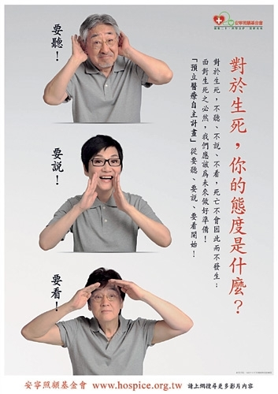
Notes:
對於”對於生死，你的態度是甚麼? “ 對於這個問題，我想各位的回答一定是同意要聽、要說和要看(資訊)。否則不會來參加今天的活動。研究顯示，在發生重大疾病或疾病末期以前，大多數病人較希望醫護人員主動早些提出討論這個議題。
大家可能知道，二次世界大戰後，生活安定下來，出生人口增加，出現所謂的嬰兒潮。當今這些嬰兒潮出生的人，走進人生的老年階段，因此，有品質的末期生命照顧就得到美國主流社會的重視而有了合乎人性化的安寧療護照顧方式。
不幸的是，我們中國傳統文化的一些誤導和民情風俗，使得民眾對有關死亡的話題被視為禁忌。(亞裔，尤其是華人)病人常常在臨終時因家屬的不能面對病人瀕死的事實、不知如何照顧，或拒絕醫護人員的建議，讓病人受了不少苦頭，死得很辛苦(我仍記得照顧的第一個病人，因呼吸困難而喘息，末期病人的呼吸困難是無法只用氧氣就能解決問題的，而必須使用嗎啡，然而，當時的醫療法因嗎啡是管制藥品而限制使用，因此，低量嗎啡只能讓病人舒服個半小時，就得繼續喘息，忍數小時後到下一次可以給藥的時間。想想這種情形，我們都不希望這種事情發生在我的家人，甚至自己身上。

Slide 3
課程目標
預立醫療自主計劃(Advance Care Planning) 的重要性
末期生命照護的醫療選項
完成預立醫療自主計劃書- 填寫醫療照護事前指示(Advance Health Care Directive; AHCD)
維持生命治療醫囑 (Physician Orders for Life-Sustaining Treatment; POLST)
安寧療護
Notes:
Objectives:
- Define Advanced Care Planning (ACP) and the different types of Advanced Directives (AD)
- Understand challenges of ACP
- Organize an approach for discussing ACP and AD to patients and caregivers

Slide 4
預立醫療計劃的重要
改進末期生命病人的生活品質
尊重個人的自主權，能根據個人的價值觀、信仰、人生體驗、意願或偏好，訂定個人生命末期的醫療目標
提供開放討論，和家人和醫護人員分享自己對生命的價值觀和醫療意願的機會
醫療照護事前指示(Advance Health Care Directive; AHCD)讓當事人自我表達醫療意願，減除家人意見不同而可能產生的衝突和壓力。
Notes:
Provides autonomy
Clarifies goals
Provides open communication and shared understanding
Improves quality of life for patient
Reduction of cost (1/3 of Medicare dollars are spent on last month, and often undesired by patient)
IDEALLY, PROVIDERS PROVIDE INFORMATION, INICITS PATIENT VALUES, PREFERENCES AND PERSONAL GOALS PERTAIN TO END-OF-LIFE CARE.

Slide 5
預立醫療自主計劃 Advance Planning
依照醫學倫理的自主原則(autonomy)，醫護人員解說一項醫療的目的、效果和可能的危險性後，有能力做決定的病人有權自己或授權醫療代理人作主決定。病人所作決定不能因此傷害他人或違反法律。
生命末期病人和指定代言人隨著病程的發展， 事前決定病人自己在生命末期希望得到的醫療 照護。
“末期生命”的時間是指會因病程自然死亡(不感到意外的) 的最後一年。”
Notes:
assist patients, family, and designated decision makers to plan for preferences and decisions as patient progresses through a serious illness
Include invasive treatment preferences like artificial life support and length of those treatments (ie: ventilator support)
Can be written or oral
介紹預立醫療自主計劃的目的，是讓民眾了解生命末期的醫療選項，使用自主權決定希望被照顧的方式，而醫護人員也能本著醫療倫理的四大原則，透過病人在預立醫療自主計劃中的意願。
醫療倫理的研討會在

Slide 6
末期生命醫療照護的選項
心肺復甦術(Cardiopulmonary Resuscitation; CPR):
要做
不做 (允許生命終止時的自然死亡)
醫療處理:
全程醫療- 用一切有效方式延長生命為主要目的。
接受呼吸插管、使用人工呼吸器等進一步的呼吸治療；
需要時給予心臟電擊治療。(全程醫療的期間)
選擇性醫療- 避免難以承受的醫療措施，如不做人工呼
吸插管，使用非侵入性的正壓呼吸器；接受藥物醫療、 靜脈抗生素和補液。
舒適為主的醫療- 提供最大舒適、減輕疼痛為治療的主要
目標，如安寧療護。如果病人所在處無法提供舒適照顧，
病人需轉院所。
人工方式的營養提供:
管餵食 (長期、期間或不接受管餵食)
Notes:
心肺復甦術: 用於沒有心跳、沒有呼吸。救起來，又會再發生沒有呼吸、心跳的情形，是否又要再做?
雙手束縛，避免拔管，鎮靜藥物；住在加護病房，家人無法在旁

Slide 7
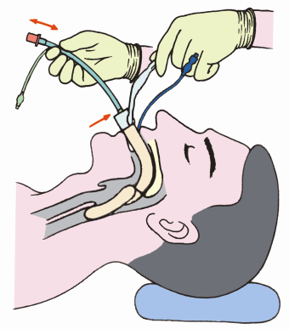
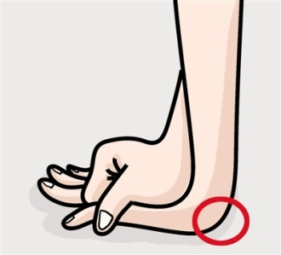
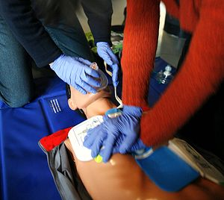
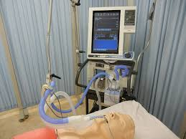
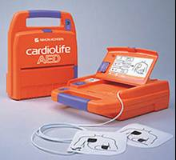
心肺復甦術 CPR (cardiopulmonary resuscitation)
心肺復甦術是呼吸突然或漸趨停止時，馬上通過氣管插管，而後連接到氧氣罩或呼吸器，給予病患氧氣。如果心臟停止跳動，緊急實施心臟按摩或電擊，使得心臟重新再開始跳動。
按壓胸部到2英吋( 5公分)深度， 每分鐘100次的速度。
Notes:
What are the potential side effects of CPR? CPR [cardiopulmonary resuscitation] in the hospital is violent and may result in broken bones,” she added, and results in worse quality of life. Patients should be told as much, Dr. Prigerson believes. “The point isn't to scare patients, but to paint a realistic picture,” she said.
People often think of CPR as it is depicted in TV shows, but this is very different from what happens in reality. Reality rarely looks like what we see on TV. There are usually some serious side effects of CPR, like broken ribs, brain damage from lack of oxygen, and weakened lungs. Therefore, even if CPR is successful, there is a high likelihood you would remain in the hospital in critical condition and on breathing machines.

Slide 8
心肺復甦術的成功率及可能的合併症
研究指出，醫院外接受CPR而存活的人約15%；在醫院接受CPR 被救活的機率是20%左右。
身體軟弱、在療養院或重病者因身體的健康狀況，CPR成功率更低些。在療養院的成功率少於 3-5%；失智症老人中，只有2%得到存活；癌症晚期病人大約只有1%左右的存活率。
根據統計，50% 的人有永久性的腦部損傷(甚至成為“植物人”)，而須終身靠機器呼吸和/或灌食為生、24小時仰賴他人照顧。
大部分的人都有肋骨骨折、胸骨骨折、胸部瘀青或因電擊發生皮膚灼傷的醫療問題。
有些病人因插氣管過程中導致氣管、食道或牙齒損傷。
Notes:
How successful is CPR? 車禍、淹水等意外事件
For patients who receive CPR in the hospital, about 17% will survive CPR to be discharged from the hospital.¹ Slightly more than 2% survive with good brain functioning.²
For adults who are frail, in nursing homes or very ill, the likelihood of CPR working is much lower. In residents in nursing homes, the chance of CPR working at all is less than 3%.³
Will emergency responders honor my wishes?
To be effective, CPR has to be started within a few minutes of your heart stopping. If something sudden – an accident or injury – were to happen to you, the emergency responders or bystanders who know CPR would try to restart your heart immediately, since they probably would not have access to your Advance Health Care Directive at that urgent time.
So, if your choice is to allow a natural death and not attempt CPR, it is important to know that it is impossible to guarantee what will happen outside of the hospital. But we still encourage you to talk with your health care agent about CPR and document this in an Advance Health Care Directive. This way, if your heart and breathing ever stopped in a hospital setting, the medical team would know if you would want CPR.
How do I decide whether or not I want CPR?
Whether or not you want CPR attempted if your heart and breathing stops is a personal choice. It is also a decision that may change as you age or if your health declines.
It is common for healthy adults and younger adults to want attempts made to restart their heart. While the survival rates are low overall, if you are in a healthy condition when you receive CPR, the likelihood of a good outcome is much better.
We encourage you to do some reflection before deciding whether or not you want CPR attempted. It may be helpful to discuss your thoughts with your health care agent or someone else close to you.
Here are some questions to help you consider whether or not you want CPR attempted:
What personal experience have you had with family or friends who have had CPR? How did that experience affect your own decision?
What do you see as the advantages and disadvantages of CPR?
What outcome would you expect if CPR were performed and you survived? For example, think about your level of functioning, ability to be independent, or the chance of living in a nursing home the rest of your life.
What outcome would be unacceptable to you? For example, some would consider it unacceptable if they required 24 hour nursing care, were unable to communicate with loved ones, or needed a permanent life sustaining treatments (like a breathing machine).
Are there others you would like to have participate in this decision-making process?
Do you have other questions that need to be answered before deciding?

Slide 9
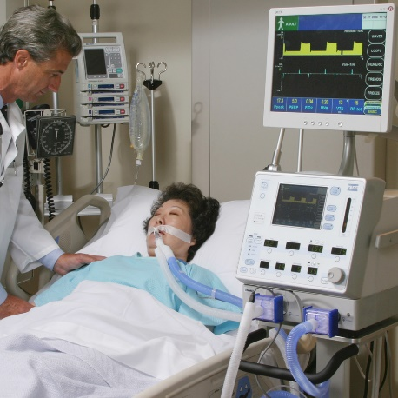
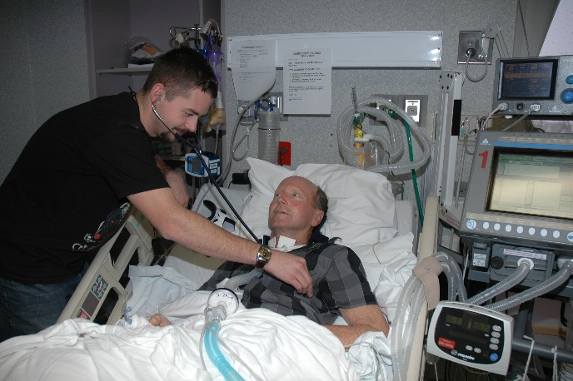
人工呼吸器 (mechanical ventilator)
病人接受氣管內插管後，機器經由管子將高濃度的氧氣強制打入肺部。通常病人會給予藥物以減輕插管的不舒服，或或病人雙手被輕微地束縛，掙扎拔管的可能。
等到病人能自行呼吸足夠的氧氣時，就會拔除氣管插管。
數天後，如果病人仍須依賴呼吸器，醫生可能需要在病人的氣管上做一個氣管造口。

Slide 10
使用人工呼吸器的合併症
氣管插管造成對聲帶的傷害，說話可能有困難
氣管插管傷到喉嚨，吞嚥可能困難
容易感染難以治癒的肺部感染
呼吸器對肺部造成的傷害。
在生命末期的病人，因為肺部本身的病情惡化或器官衰竭關閉，幫助的效果不大。

Slide 11
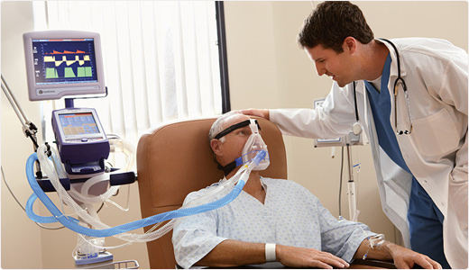
非侵入性的正壓呼吸器 （Positive Airway Pressure）
呼吸衰竭的病人不希望插管用呼吸器治療，但希望積極的方式接受氧氣補助。
評估末期生命病人的生活目的，和治療的好處及負擔
用於呼吸肌軟弱導致的呼吸困難和衰竭，如ALS的病人，可以改進生活品質和延長存活。當然有些ALS的病人考慮生活品質而終止使用BiPAP。
Notes:
6

Slide 12
癌症末期接受化療的爭議
 | 接受化療 | 沒有接受化療
轉送到加護病房 (CPR、人工呼吸器) | 14% | 2%
死於加護病房 | 11% | 2%
延後安寧療護轉診 (死前的最後一周才選擇安寧療護) | 54% | 37%
Adopted from: Wright AA, Zhang B, Keating NL, et al. Associations between palliative chemotherapy and adult cancer patients' end of life care and the place of death: prospective cohort study. BMJ. 2014;348:g1219.
Notes:
Chemotherapy for terminally ill patients “may do more harm than good,”
Patients undergoing chemotherapy during their final weeks of life were more likely to experience painful, aggressive procedures and to die in the intensive care unit (ICU) rather than at home, These patients saw no survival benefits from end-of-life chemotherapy but they faced higher rates of cardiopulmonary resuscitation, mechanical ventilation, or both, during their last week of life (14% vs 2%).¹
Patients receiving chemotherapy were also far more likely than other patients to die in an ICU (11% vs 2%) and to be referred to hospice late, within a week of death (54% vs 37%),

Slide 13
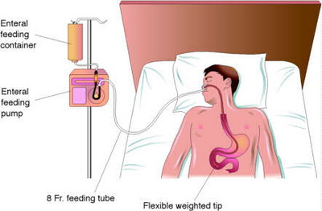
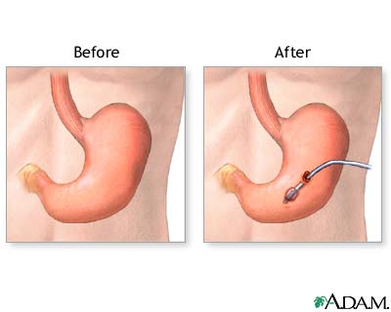
管餵食和人工補液
通過餵食管的留置，將流質食物經由鼻胃管或胃腸造口送進病人的胃腸部。人工補液是為無法飲用足夠水分或吞嚥困難的病人，提供的靜脈或皮下注射的醫療方式。
對於末期生命無法進食的病人，停止進食是正常的。
研究指出人在瀕死期間是不會有飢餓或口渴的感覺。
餵食管留置灌食或勉強餵食可能造成的傷害:
胃部不適、嘔吐和腹瀉
腿部積水浮腫
肺積水，造成呼吸困難
病人焦躁或不清楚時會拔除鼻餵管，導致重複插
管的問題
食物回流造成吸入性肺炎等感染問題
餵食管產生更多尿液和糞便，增加皮膚潰爛問題
Notes:
They should be made to realize that when you have tubes connected to your nose and mouth that you are unable to communicate with family and friends, are often unconscious, and may not be able to swallow without mechanical assistance,”
人工方式給水分或營養屬於醫療措施。病人可以拒絕，或醫護人員覺得負擔多於對病人的好處。

Slide 14
有關死亡的思維
聖嚴法師，“---,當我們能面對死亡的課題，接受它、處理它，最後才能放下它。”
單國璽樞機主教，“將身體交給信賴的醫師；將生命交給信實的神；將心情交給自己，學習放下憂慮和不捨。”
學者田立克，「不計一切代價去努力延長病人死亡的時間，是一種殘酷的仁慈。」適當處理不捨的情緒，適時放下是真愛。
Notes:
1.聖嚴法師曾提到的: 不要怕談論死亡，如果不談死亡就不會死，我們就不談。當我們能面對(而不是逃避) 這個死亡的課題，接受它，處理它(有關死亡的相關問題，處理完成尚未完成的事情，如死後的家人安排、財務處理、身體處理、，等等)，最後才能放下它。
不要隱瞞實情。臨終的人，一定要能夠接受自己將要往生的事實，後事(通常需要3-6個月的時間)才能交代清楚，家屬與病人都有共識，才能做到 趙可式 博士所說的：「道謝、道歉、道別、道愛」；唯有如此，病人才能夠放下重擔，才能走得坦然、走得安詳
死亡是ㄧ種失去，常常我們在失去後才學習到珍惜。如果在我們健康的時候，就學習死亡的課題，我們將更會珍惜我們所擁有得一切，讓我們的生活過得更有意義。當我們告訴末期生命的病人過好每一個今天，(憂慮讓你有事做，却沒有進展)的同時。我們是不是也想到”昨天(yesterday)是歷史(history)、明天(tomorrow )是秘史(mistry)、只有今天(today) 是一分禮物(present)。”因此，好好把握現在。活在當下。
善生: 活得有愛、有意義; 善終: 死得安詳、有尊嚴; 善別: 適當處理不捨的情緒
信賴的醫師(trust) ; 如果憂慮讓我們能得到失去的健康，我們就憂慮吧!
Doctor (providing palliative chemotherapy during the patients’ last weeks of life) may dishonor the Hippocratic oath by offering such patients chemotherapy that does more harm than good.”
過去可能順著病人和家屬；現在則秉著醫療倫理”害多時利時”堅持不做 化療，保護病人免受傷害。
“人定勝天”嗎? 花開花謝、春去秋來都有定時。我們是大自然的一分子，也就離不開大自然的法則。好好照顧健康，讓我們的生活有品質。
5. 在英國、紐西蘭、澳洲等這些生命末期照顧良好的國家，像這樣的病人是不會被插管的，即便家屬強烈地要求，醫生還是會拒絕給予這樣無效的醫療，而這些國家的醫療人員都受到國家法律的保障，醫生會以病人最大的利益來考量，醫生不會做無效醫療這類愚蠢的事。
生命的意義，是用思想和行動來衡量，而不是用生命的長短。」當一個人躺在病床，插滿管子，靠維生設備維持生命，無法行動、無法言語，甚至因躺太久而引起褥 瘡、深可見骨，沒有生活品質，只能維持著所謂的「生物式的生命」。這麼痛苦地活著，只因為我們想滿足：「我們的長輩還活著，我們還擁有他。」這樣的愛實在 太自私了
學者田立克有句名言：

Slide 15
填寫“醫療照護事前指示”的步驟 Advance Health Care Directive (AHCD)
醫療自主計劃的討論: 隨著病人病情的改變， 持續和醫護人員溝通有的醫療選項。
指定醫療代理人:能夠依照個人的價值觀和希望的照顧方式，執行最合宜的醫療決擇。如果沒有選擇醫療代理人，也可以自己填寫希望的醫療選擇。
存檔填寫好的事前指示表格書: 一份在醫院病歷、一份給醫療代理人、自己手邊一份。
定期覆閱和修改: 如末期病情進展改變時、病人意願改變時、短時間內時常往返住院時，做適時的覆閱修改並更改日期。
Notes:
Dot 1:
討論 ACP 的方式（Approach to ACP Discussion）
1. Familiarize self with state and facility laws and know who facilitates this discussion
Assess understanding of patients through dialogue with family about their knowledge of diagnosis and prognosis. Know how much they want to know, and who they want present for the discussion. LISTEN!
Evaluate willingness to discuss: More likely to discuss if approached by family, MD, or clergy
討論的步驟和內容
Present factual information: Give realistic outcomes from procedures; Risks and benefits of CPR, mechanical ventilation, invasive procedures, burden of treatment
Provide educational materials
Encourage completion of AD-use clear language and instructions (if unwilling, encourage patient to discuss wishes with family)
例如:
在何種情況下，你會想要活著? 如果腦嚴重受傷，永遠醒不過來(像植物人)，無法和家人溝通，而需要他人24小時(全時間)照顧你?靠呼吸器呼吸?靠灌食維持生命?在療養院?在家中?
You may wonder, “how can anyone plan for all possibilities?” You cannot anticipate every possible scenario, but there is one particular situation that is important to think through in advance. Your thoughts and feelings about what you would want in this situation will be informative for you and your agent.
=========
摘要:
Step 1: Initiate discussion: Share medical knowledge, identify misconceptions, identify patient values and what they wish to know (Clarify understanding of ACP and inform that if no proxy appointed, decisions become responsibility of family and health care team. Encourage discussion with family)
Step 2: Complete AD documents using clear language for specific situations (如希望急救的時間是20分鐘). Follow state regulations
Step3: Review ACP regularly in times of acute illness. ACP can be revised; document changes, and what remains unchanged. Be specific! This documentation may be only reference for compelling evidence. Use quotes

Slide 16
指定醫療代理人 Designated Agent
醫療代理人是病人信賴、瞭解並尊重病人對生命的價值觀和意願(即使和本身不同)，考量病人的利益而做決定(即使牽涉到個人的情緒影響)者。
醫療代理人通常有兩位:主要代理人和次要代理人。可以是家人、朋友或重要關係人。當主要代理人不能聯絡到、因各種因素無法做決定或已死亡時，由次要代理人做決定。
Notes:
病人無法自我作決定時 (根據醫師的醫療判斷)
Capacity: Impairment or disturbance in the brain resulting in a person unable to make decisions on own. Not determined by age or appearance. Lack of capacity is when patient cannot understand or retain relevant information long enough for making decisions
Competancy: determined by court of law
病人清楚但全權交代理人處理；

Slide 17
醫療代理人的職責和執行生效
職責: 為病人做醫療決擇，包括
醫療檢查、測驗、治療、手術
提供、不提供、停止提供各項維持生命的醫療措施
查閱病歷或允許釋出給第三者使用
決定照顧的醫療機構和醫療照顧人
死後遺體的處理，包括解剖
執行的生效:
當病人無法自我作決定時
病人授權代理人處理醫療相關決定時的立即生效。

Slide 18
“醫療照護事前指示表格”樣本
在加州，醫療照護事前指示表格填寫完後，需要有兩位
見證人簽名(其中一位必須無血緣或財產利益關係)，或在
一位公證人(Notary Public)的面前簽名，完成它的合法性。
CALIFORNIA
Advance Directive
Planning for Important Health Care Decisions
Caring Connections
1731 King St., Suite 100, Alexandria, VA 22314
www.caringinfo.org
800/658-8898

Slide 19
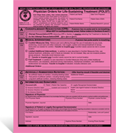
維持生命治療醫囑 Physician Orders for Life-Sustaining Treatment (POLST)
使用POLST的目的是透過有效溝通，依據重症病人的病情發展和醫療意願，醫護人員遵照執行的醫療計劃。
POLST不取代醫療照護事前指示(AHCD)。POLST一份隨身帶在重病病人身邊，一份存檔在醫院、療養院所或家中的床旁。
POLST由醫師填寫簽名，並有病人或指定代理人的共同簽名。配合醫院規章，醫師事前給的口頭醫囑，事後簽名也生效。如果使用翻譯表格解說，病人或指定代理人需要簽名在英文版本。
影印和傳真的版本是合法和有效的。醫院的版本可能的話，是粉紅色的原版。
2014年10月1日後有新的修正版本。舊的版本仍然有效。
Notes:
接近生命末期的病人，往往可能得到他們並不想要的治療。這些治療可能無法幫助他們活得更好或更久，有時甚至可能造成痛苦。這份表格表達你想要的醫療方式。
摘要:
Step 1: Initiate discussion: Share medical knowledge, identify misconceptions, identify patient values and what they wish to know (Clarify understanding of ACP and inform that if no proxy appointed, decisions become responsibility of family and health care team. Encourage discussion with family)
Step 2: Complete AD documents using clear language for specific situations (如希望急救的時間是20分鐘). Follow state regulations
Step3: Review ACP regularly in times of acute illness. ACP can be revised; document changes, and what remains unchanged. Be specific! This documentation may be only reference for compelling evidence. Use quotes

Slide 20
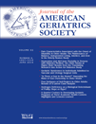
“維持生命治療醫囑”的執行 讓末期生命病人的願望得到尊重 End-of-life Wishes are Respected Through POLST
最近發表在美國老人醫學會雜誌的一篇研究報告顯示，遵行“維持生命治療醫囑”的計劃，可以有效地影響末期生命病人所接受到的照護。
這篇研究追蹤58,000位自然死亡的病人，根據他們喜歡的醫療選項和他/她們最終死在醫院的比例相關性。
喜歡的醫療選項 | 死於醫院的比例
全程照護 | 44.2%
沒有填寫 | 34.2%
舒適照護 | 6.4%
Notes:
A new study published in the Journal of American Geriatrics Society shows that participating in the Physician Orders for Life-Sustaining Treatment (POLST) program can effectively influence the care patients receive at the end of life. This is the first study we are aware of that looks at the association between preferences expressed in POLST orders and where people ultimately die.
Study details
The study, “Association between Physician Orders for Life-Sustaining Treatment for Scope of Treatment and in-Hospital Death in Oregon,” looks at the death records of 58,000 Oregon residents who died of natural causes in 2010 and 2011, and compares location of death with the medical treatment patients indicated on their POLST. Of the 58,000 death records, nearly 18,000 could be matched with a POLST in the Oregon POLST registry.
Only 6.4 percent of patients who specified “comfort measures only” orders on their POLST died in a hospital, while 44.2 percent of patients who chose “full treatment” died in a hospital. Additionally, 34.2 percent of people with no POLST form died in a hospital.
This study shows patients’ wishes are being matched with how they die. Essentially, if a patient said they wanted every intervention, they were more likely to die in a hospital than someone without a POLST form.
The connection to POLST in California
In 2012, the California HealthCare Foundation published a study called “Snapshot Final Chapter: Californians’ Attitudes and Experiences with Death and Dying,” and discovered that 70 percent of Californians would prefer to die at home. However, only 32 percent of deaths occured at home, while 42 percent occured in a hospital, and 18 percent in a nursing home.
The “Association between Physician Orders for Life-Sustaining Treatment for Scope of Treatment and in-Hospital Death in Oregon” study clearly shows there is a strong correlation between POLST and location of death, and illustrates that POLST is the best choice patients can make to remain in control of medical care they receive toward the end of life.
POLST is one of the most powerful tools available to make healthcare wishes known, even when patients are unable to speak for themselves.

Slide 21
安寧療護 Hospice
“安寧療護”是提供以病人為中心，病人舒適為優先考量，包括全人、全程、全家和全醫療團隊的支持性照護方式，讓末期生命病人有品質地生活到生命的最後一刻。
對末期生命者的“善終”
透過醫療團隊(醫生、護士、醫療社工、靈性關 懷師、其他醫療諮詢人員、義工)，得到身、心、 靈各方面有品質的舒適生活
死得安詳、有尊嚴、被尊重
對照顧者的“善生”
提供照顧者 支持和死者走後13個月的悲傷陪伴。
對生死雙方的“善別”
能及時完成道謝、道歉、道愛、道別的四道人生。
能夠適當處理不捨的情緒，坦然放下。

Slide 22
聯邦醫療提供的安寧療護福利
資格：估計生命期6個月或更少
支付：
所有和末期疾病有關的藥物和醫療器材
一週七天、每天24小時可以使用的電話專線
常規的居家照顧：醫護人員每週家訪追蹤
病人住院: 經由醫師批准，住院解決重大的醫療問題，如疼痛控制
持續居家照顧: 醫護人員居家照顧病人症狀問題
喘息照顧：提供連續五天的病人療養院住院，讓 家屬暫緩休息

Slide 23
參考資料
Coalition for Compassionate Care of California (CCCC) website information (http://coalitionccc.org/tools-resources/advance-care-planning-resources/)
Hospice and Palliative Nurses Association, “Advance Care Planning”
E. K. Fromme, MD, etc., “Association Between Physician Orders for Life-Sustaining Treatment for Scope of Treatment and In-Hospital Death in Oregon” June 6, 2014. DOI: 10.1111/jgs.12889)
單國璽樞機主教與聖嚴法師對談 https://www.youtube.com/watch?v=I8HpeRa0lgo

Slide 24
推動預立醫療計劃的障礙
認為“死亡”是一個不愉悅而禁忌的話題，一切等發生時再說，往往留下生死兩遺憾的結局。
和父母親討論死亡，違背傳統的孝順觀念
抱著“不談不發生”的忌諱心態，不喜歡討論
缺少醫療資訊，尤其是當疾病無法治癒時，病人或家屬不知可以有的醫療照護選項
醫生沒有時間和缺乏專業溝通的訓練 和病人討論末期生命的醫護方式， 導致醫療關係惡化、放棄病人，等等的誤解。
Notes:
缺少未雨綢繆的意識；ㄧ旦發生時，亂了手腳。我希望趁他現在還有意識(3-6個月)、還能講話時，能及早做安排，以免之後昏迷，無法和家人話別，這對病患、對家屬來說都會是很遺憾的事。
：什麼叫做孝順？孝順除了讓父母過得好，不要忤逆父母，在父母人生最後一程，真正設身處地為他們著想，減輕及不延長他們的疼痛，同樣是很重要的。
生命的意義，是用思想和行動來衡量，而不是用生命的長短。」當一個人躺在病床，插滿管子，靠維生設備維持生命，無法行動、無法言語，甚至因躺太久而引起褥 瘡、深可見骨，沒有生活品質，只能維持著所謂的「生物式的生命」。這麼痛苦地活著，只因為我們想滿足：「我們的長輩還活著，我們還擁有他。」這樣的愛實在 太自私了`.
“我也不想看爸爸這樣受苦，但是如果不急救，親戚和家人都會怪我不孝。」”
內心愧疚有罪惡感，想要把握最後機會好好報答彌補，所以要拖延病人死亡的時間，也不管病人有多痛苦。
因為病人有健保，比在家裡請看護照顧病人還便宜、還省事啊 (浪費醫療資源)
========
沒有足夠的資訊，病人接受不當的無效醫療，導致身心受苦、家人受苦。加上全民買(帳)單，浪費醫療資源。
Conversations should be matter-of-fact and even “blunt(直接了當)”, Vague communication resulted in patients not understanding their prognoses and not planning for their impending deaths.” Frank communication by oncologists, in contrast, can improve patients' and family members' understanding that the patient is terminally ill, she found. “And that led to more proactive and informed decision-making and greater hospice use,”
就醫療人員而言，「病人最大，家屬其次」，一切決定都應該也必須是站在病人的最大利益來考量，要尊重病人的自主權。病人有知的權利。如何告知? 一定要事先和家屬商量，要更圓融慎重地處理，事先取得家屬的共識後，再告訴患者，以期有較圓滿的結果。然而世風日下，我們又如何能知道，家屬為病人所做的決定，是為病人最大的利益做考量？還是為家屬自己的利益做考量？(如財產轉移)

